Slide 1

Lino Tadros Build a Sitefinity Application in a Day
Mon, 21 Oct | 9:00 AM – 4:00 PM
Baba Marta Room

Slide 2

Lino Tadros
President & CEO – Events XD Corporation
AI & Machine Learning Architect – Solliance Inc.
Microsoft C# MVP for 15 years
Telerik Developer Expert for 14 years
Former member of the Delphi & C++ development team at Borland.
Microsoft established Technical Speaker worldwide (52 countries) in the last 25 years.
Architect of major projects for Morgan Stanley, Johnson & Johnson, NASA, Disney, HP, Microsoft, Chevron, Shell, Dell, Bank of America, Wells Fargo, State of CA, …
Author of 7 Sitefinity books for the last 11 years
Author of the Sitefinity Certification Exam
Pluralsight Author on Sitefinity topics
Author of the Sitefinity OnDemand Videos at www.thetrainingboss.com
Expert on Web technologies, Azure Cloud, Big Data, AI & Machine Learning, iOS, Android, MVC, WPF, ASP.NET, SQL databases, Telerik Products and Testing tools.

Slide 3
Logistics
From 9:00 AM to 4:00 PM
Two breaks at 10:15 am and 2:30 pm for 15 minutes each
Lunch from 12:00 pm to 1:00 pm

Slide 4
Agenda
Explanation of the Architecture of Sitefinity
Install and Setup of a new site with the Sitefinity Project Manager and NuGets in Visual Studio 2019
Database choices of MS SQL Server, SQL Express, Oracle and MySQL
Contributions, Administrations, Design and Development
MVC Widget Development
Custom Designers with Angular
Bootstrap 4 layout management
Razor Templates for MVC Widgets
Standard API, Fluent API and ODATA API
Configuration sections
EventHub for intercepting events
Custom Modules and Dynamic Types
Best use discussion of SiteSync
Tips and Tricks for Optimization and Performance
Deployment to Azure Tips & Tricks.

Slide 5
https://github.com/TheTrainingBoss

Slide 6
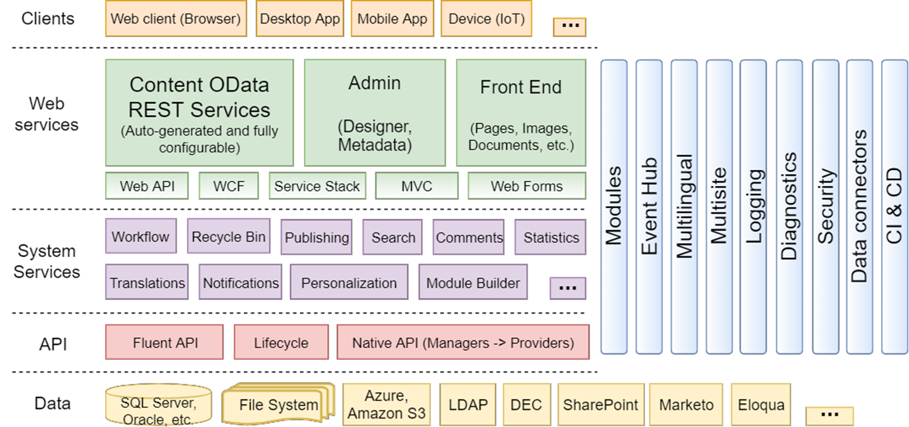

Slide 7
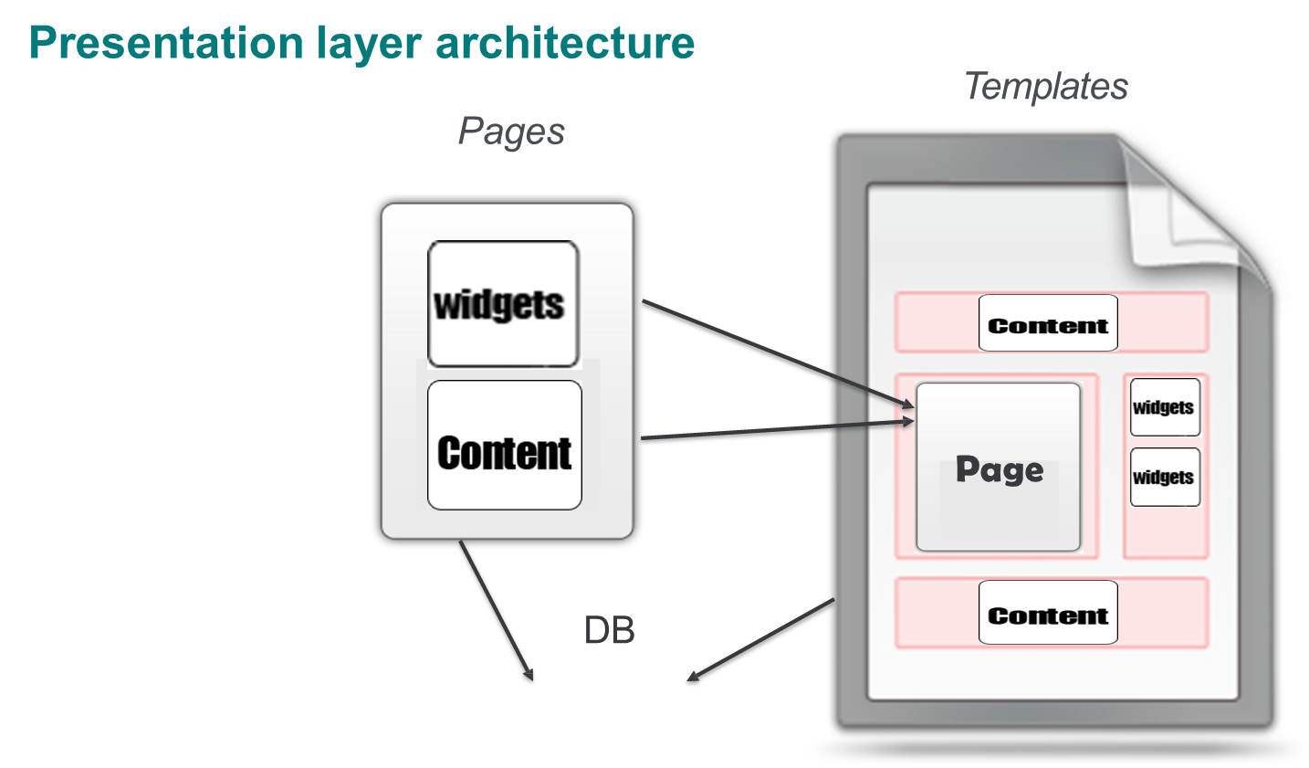

Slide 8
Demos

Slide 9

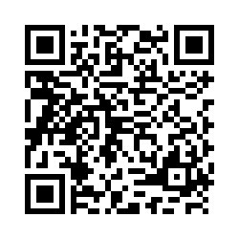
Workshop Feedback Your Time & Opinion is Valued
https://www.telerik.com/devreach/workshopfeedback

